Slide 1
Designing an ethnobotanical garden (with your help)
Katey Roden and Greg Gordon,
Gonzaga University, Spokane
discoverCoST@gonzaga.edu
“Like flesh, landscape is the living and lived surface of a body–the earth’s body. It is how earth appears to the gaze and the touch, how it surfaces to view and grasp.”
Edward S. Casey, Representing Place: Landscape Painting and Maps (2002)

Slide 2
Beyond a Land Acknowledgement
A typical land acknowledgement would call attention to our residence on the traditional homelands of the Spokane Tribe, who have lived here since time immemorial.
“Beyond a Land Acknowledgement” seeks to re-establish relationships between humans and the land in a manner that is mutually beneficial.
As such, we want to acknowledge how much indigenous ways of living with, not just on, the land shape our work on this project.

Slide 3
agenda
The Project
Traditional Ecological Knowledge
Design Criteria
Goal: have some design ideas to take to the Spokane Tribe and neighborhood councils
Breakout Session
Present Design Ideas

Slide 4
Finding Our Way—A digital community storytelling archive and NE Spokane neighborhood resource for the Children of the Sun Trail
NSC: Place-Making & Way-Finding
Gov. Inslee Celebrates Community Engagement & Climate Commitments on the Children of the Sun Trail

Slide 5
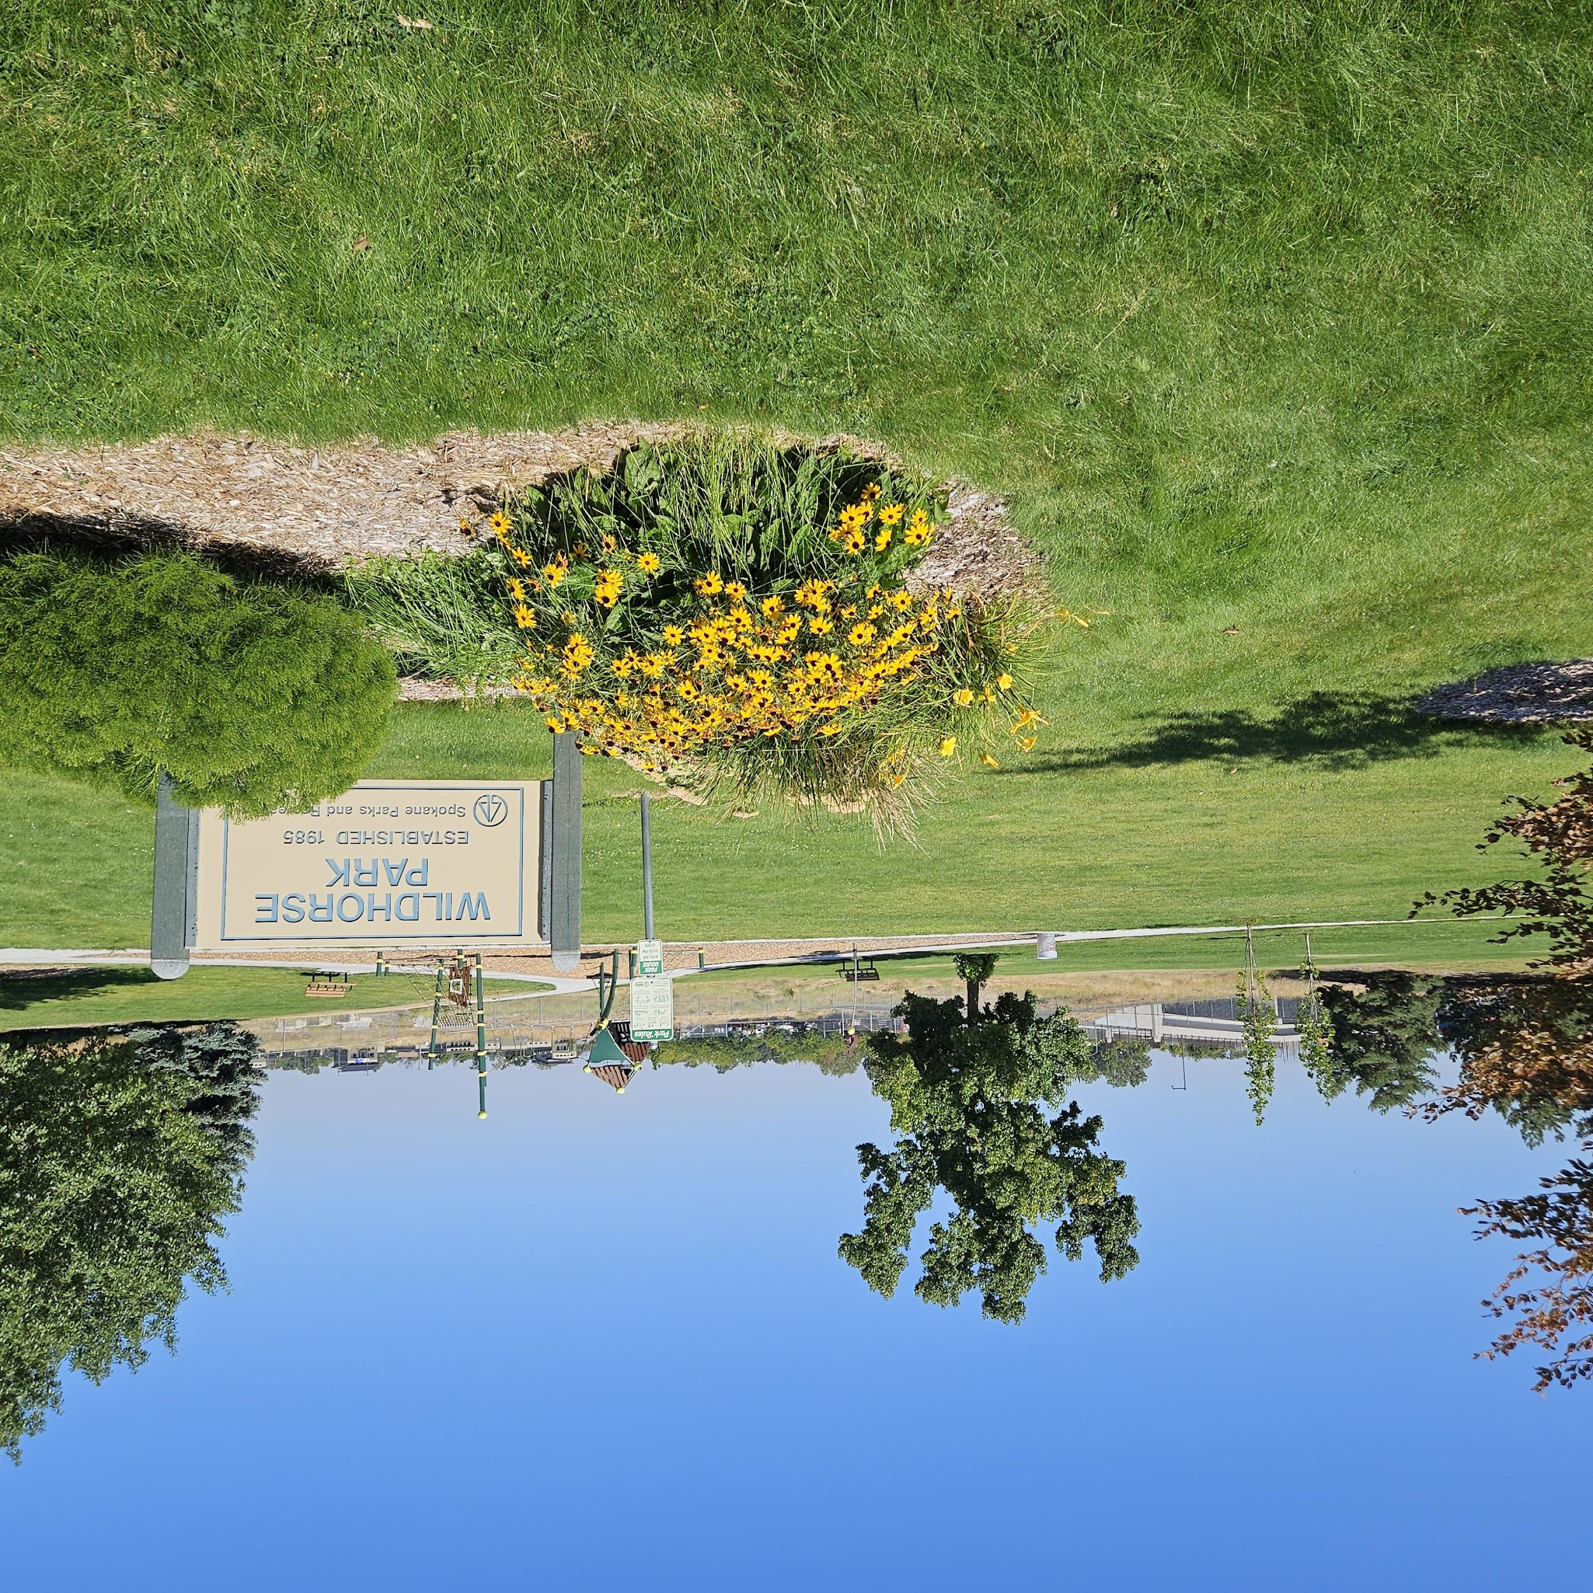
The Ethnobotanical Discovery Garden at Wildhorse Park
GOALS:
Showcase the relationship between native plants and Indigenous peoples
Provide interactive education opportunities for local schools
Improve underused public space
Provide anchor site for the Children of the Sun Trail
Not a community garden or intended for harvesting

Slide 6
Traditional Ecological Knowledge (TEK)
Accumulated knowledge and systems of practices, beliefs, and interaction with the natural environment
An ongoing practice that has been developed over thousands of years by Indigenous people through direct contact with their local landscapes
Encompasses empirical knowledge of ecological systems and processes as well as practices of livelihood activities like agriculture, hunting, and gathering
  Guided by belief in and commitment to ethical relationships between people and ecosystems
TEK is a holistic framework that integrates natural science, social and cultural factors, and religious and spiritual values

Slide 7
TEK Best Practices
TEK is specific to place: it emphasizes the interaction between humans and the local flora, fauna, and landscape characteristics and phenomena
TEK is rooted in ethics of responsibility, reciprocity, and respect between humans and the natural environment
TEK is a living and evolving practice that links past, present, and future, connecting present-day indigenous communities with place since time immemorial
TEK offers a window into the historical Indigenous relationship to place, informs current understanding of our natural surroundings, and provides a garden design framework that integrates natural science and indigenous perspectives

Slide 8
The Seasonal Round
Seasonal Rounds (or wheels) represent the annual cycle of available natural resources
Utilized by indigenous groups throughout the world
Function as a calendar of tribal activities, migration/movement, and cultural practices related to seasonal cycles
Showcase how a deep sense of place influences indigenous culture and knowledge construction
Demonstrate reciprocity between place and people

Slide 9
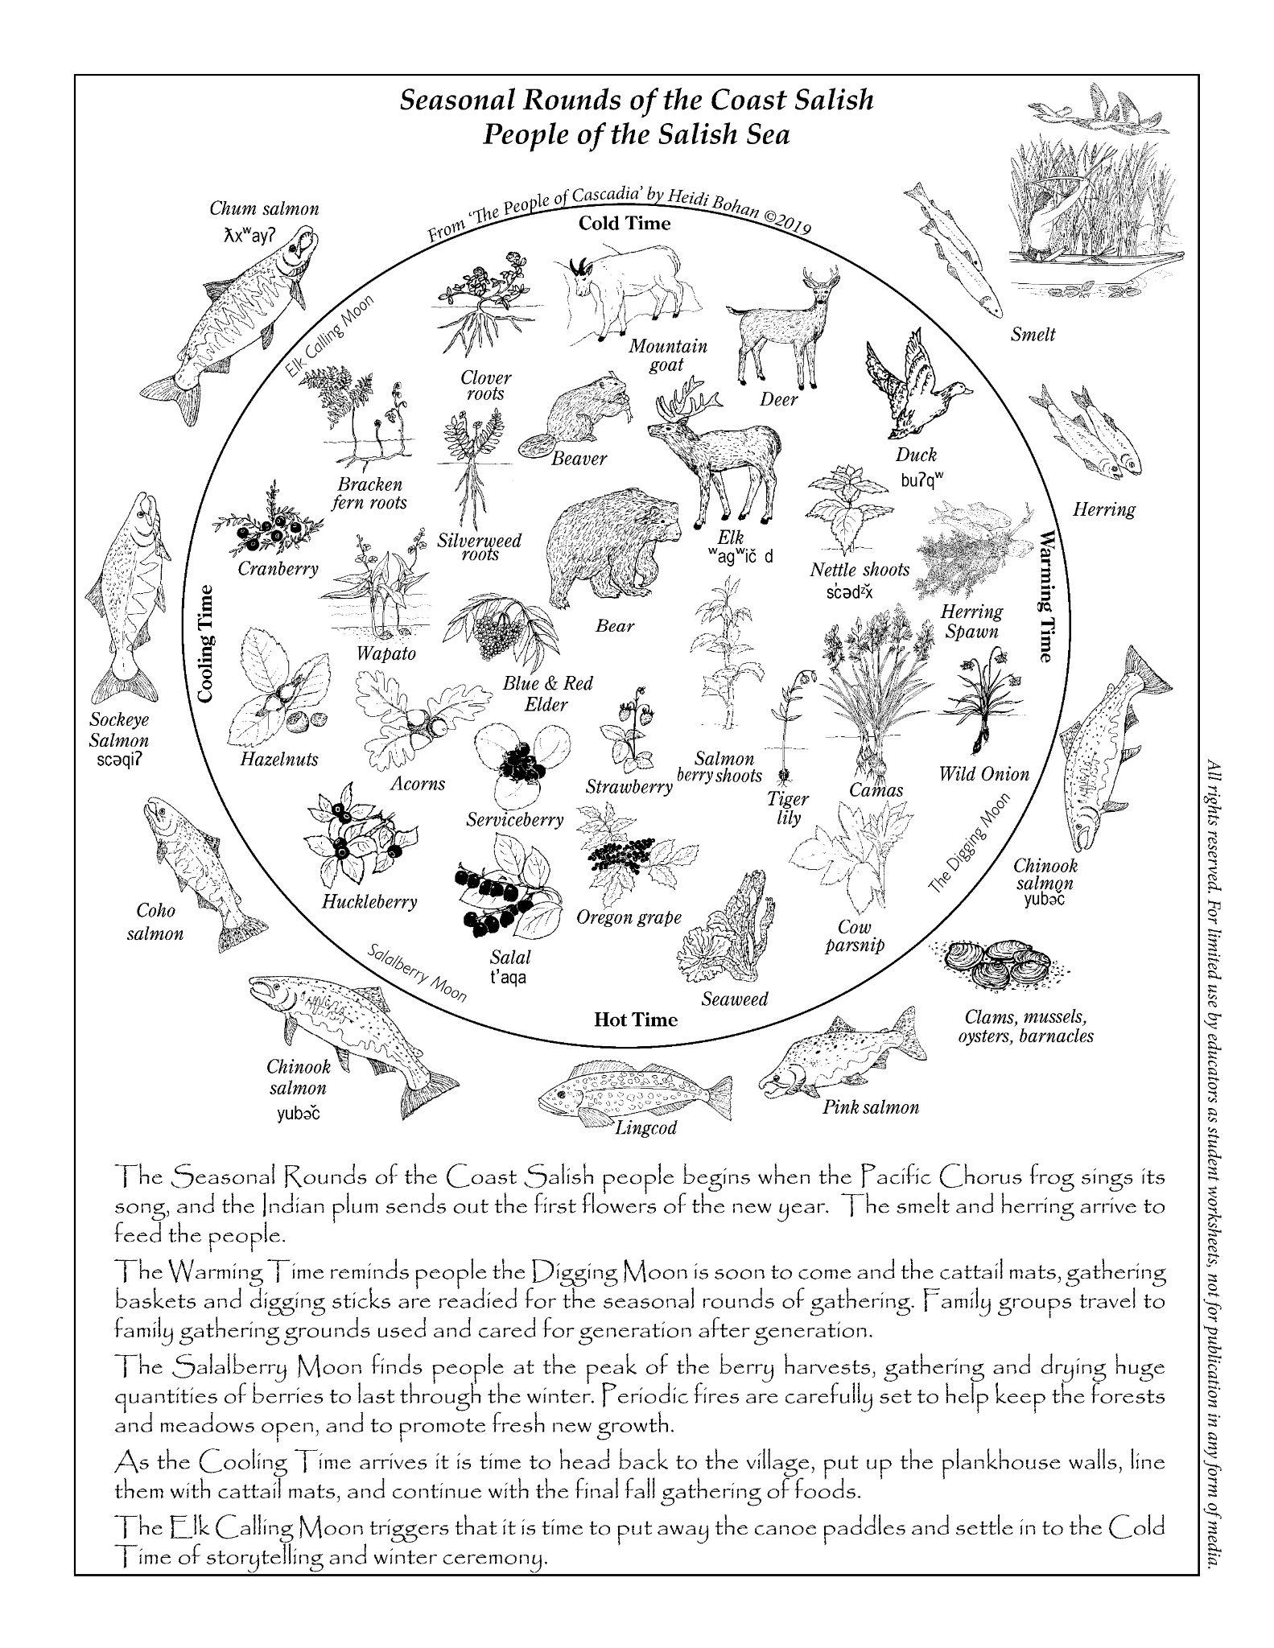
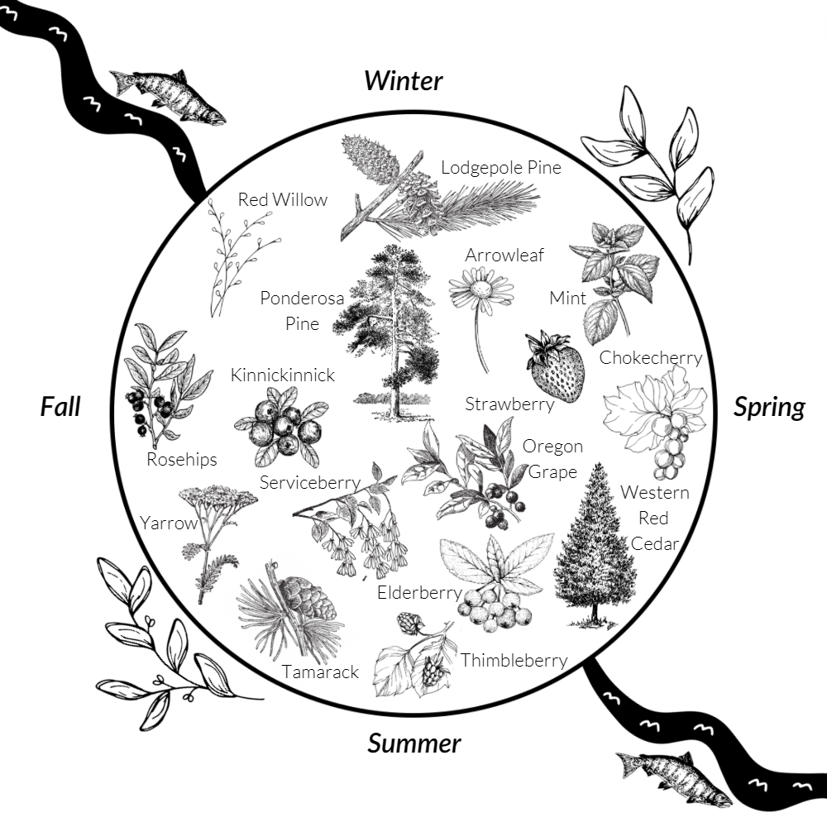
The Seasonal Round

Slide 10
WA State K-12 Educational Curriculum
Since Time Immemorial:
How does physical geography affect the distribution, culture, and economic life of local tribes?
What are ways in which Tribes respond to the threats and outside pressure to extinguish their cultures and independence?
Learning in Places:
How does the site promote learning, community, and equity, along with the site’s relationship to the land around it, humans, wildlife and plants?

Slide 11
Challenges & Opportunities: Inclusive Garden Design
What is a garden?
Western View: a “garden” is some kind of designed, organized, or managed environment. Humans bring together a variety of plants in one locale to cultivate.
Indigenous View: Nature is a garden made up of integrated and complementary ecosystems. Humans cultivate/harvest plants in their natural habitats. Includes cultural and spiritual elements
What constitutes a beautiful landscape?
Western View: European, neo-classical standards of beauty emphasize symmetry and balance.
Indigenous View: Native teachings emphasize individual definitions of beauty centered on ecological belonging and plantings as an intrinsic part of the natural environment.

Slide 12
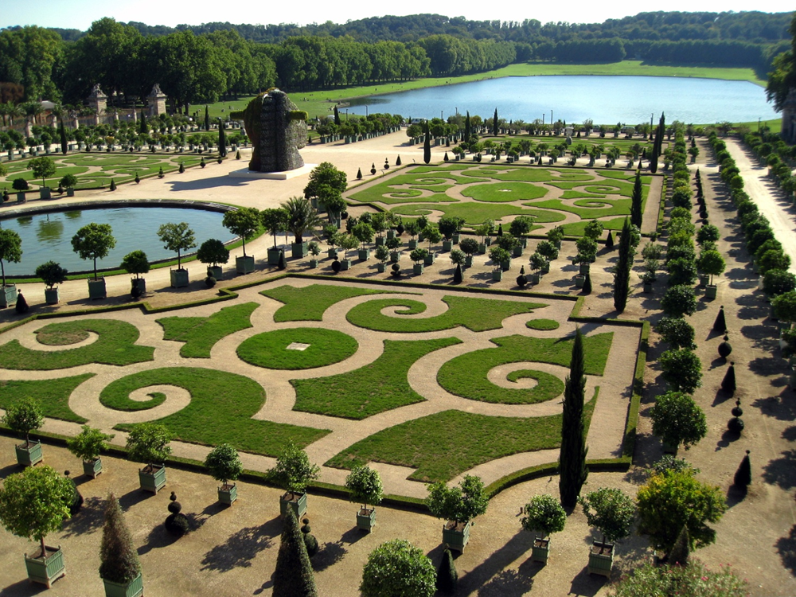
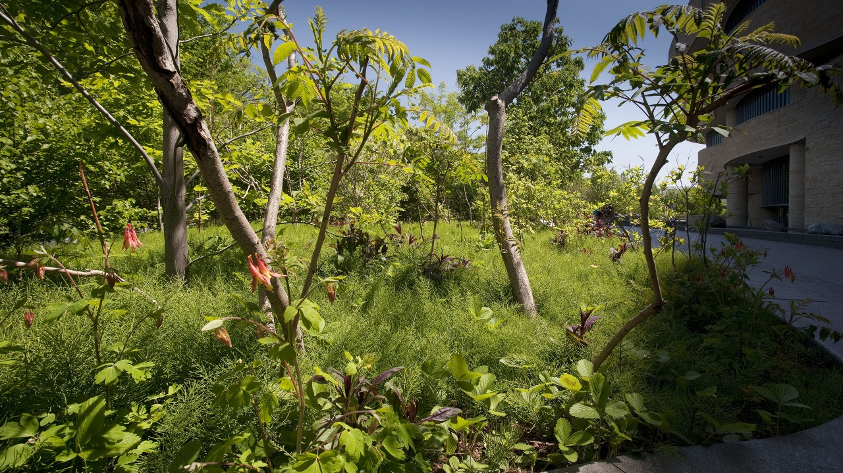
Not this Garden…
The Gardens at Versailles
Staghorn Sumac at the National Museum of the American Indian

Slide 13
Ethnobotanical Garden Design Criteria
Foreground Traditional Ecological Knowledge (TEK)
Highlight native plant species that have edible and medicinal or other importance to tribal communities
Prioritize seasonal rounds as organizing structure
Develop cohesive design and theme
Incorporate storytelling circle for 15-20 people
Acknowledges 4 cardinal directions and possibly the Spokane River
Accessible for casual visitors and K-12 students (ADA Compliance)
Focus on education and discovery—plants accessible for touch

Slide 14
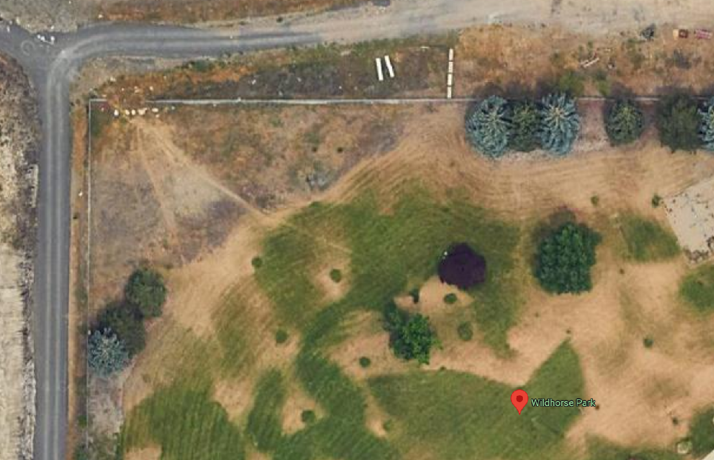
Satellite image of Wildhorse Park. The trail forms the western boundary.

Slide 15
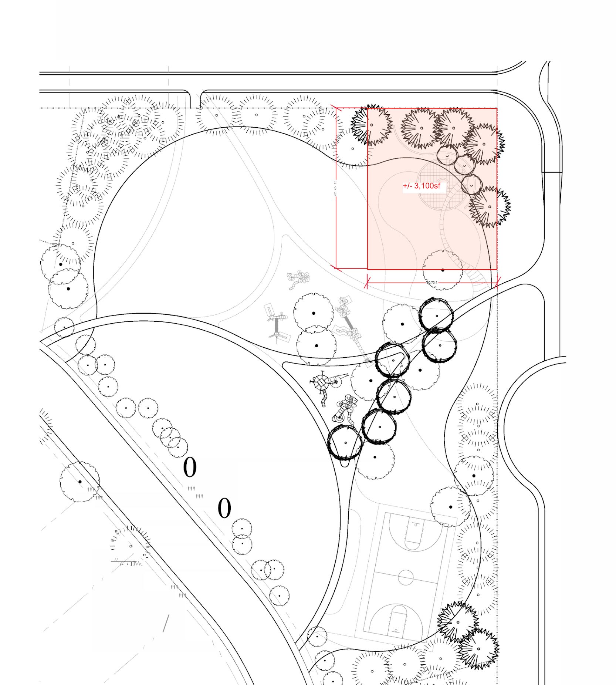
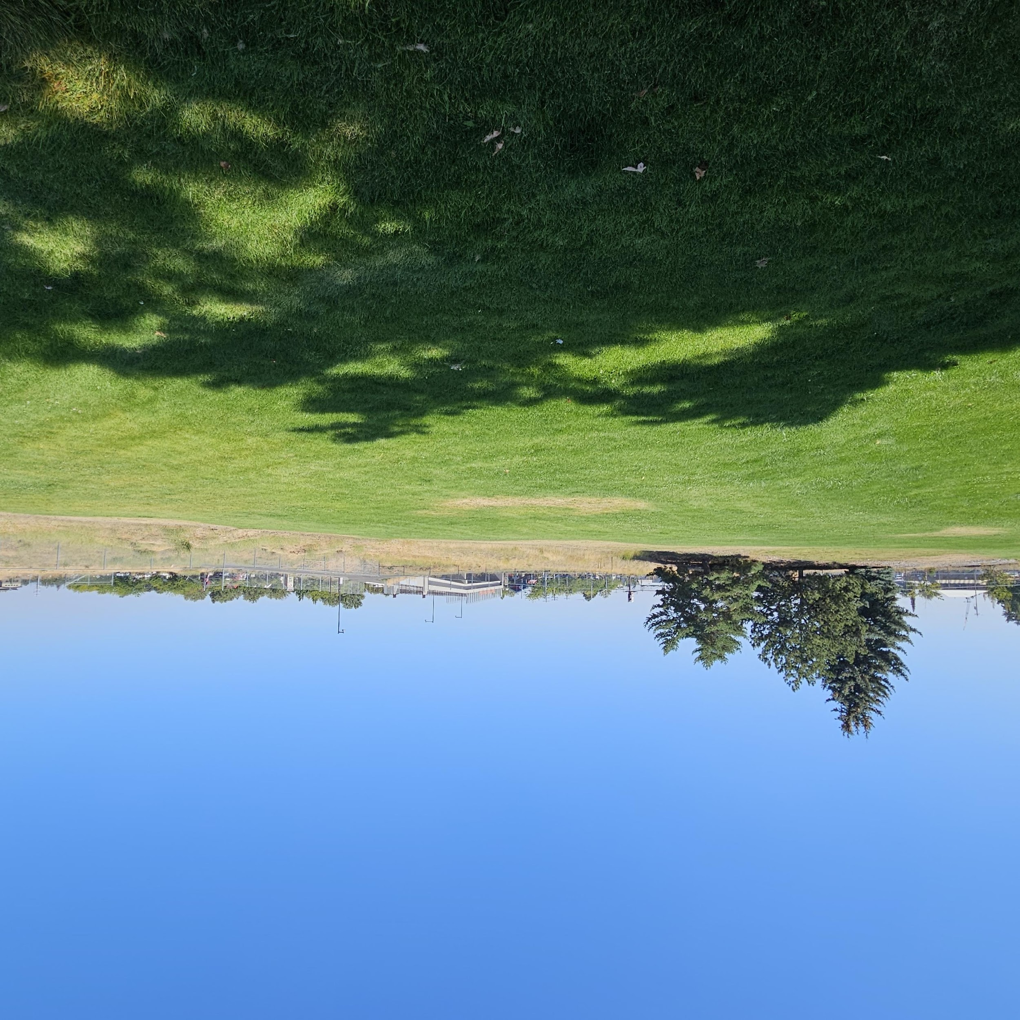
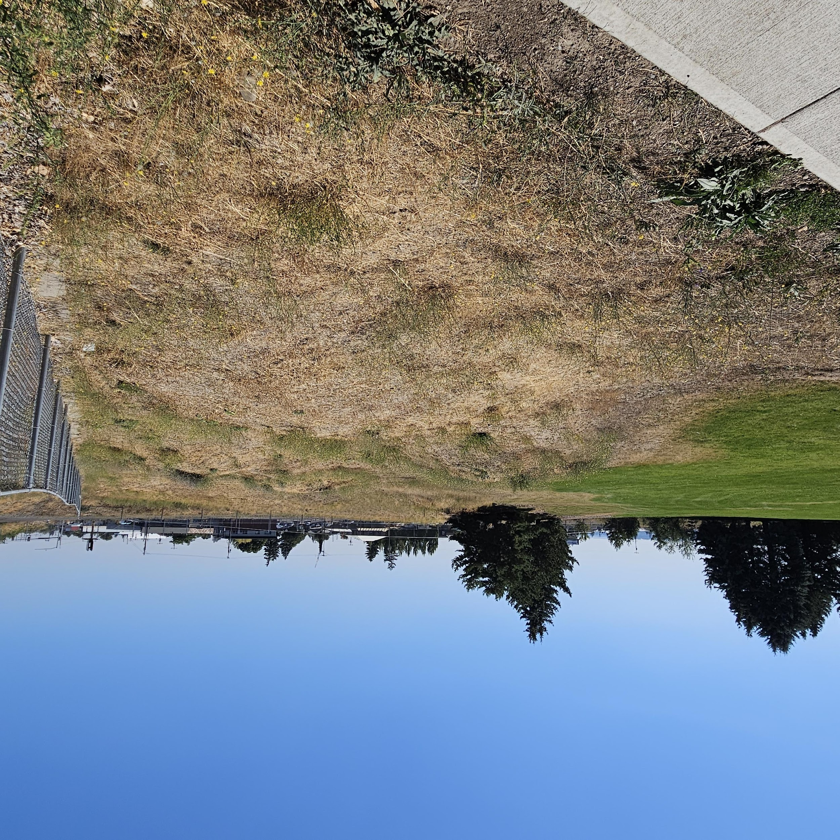
The Site, approx. 85 x 170 feet.

Slide 16
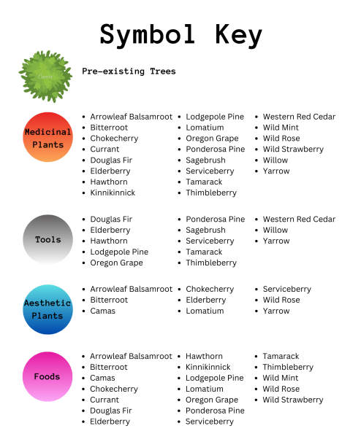
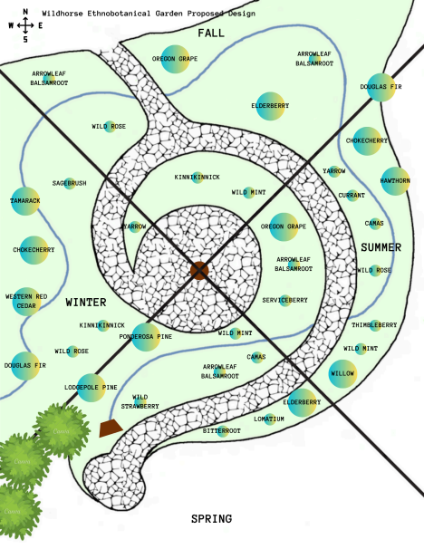
selecting visual aids
ENHANCING YOUR PRESENTATION

Slide 17
How might you apply TEK & design criteria to build an accessible, inclusive, educational Discovery Garden in Wildhorse Park?
Workshop ideas in small groups
Share out with community
Let us know if you might be interested in helping on our project!

Slide 18

thank you
Greg Gordon and Katey Roden
discoverCoST@gonzaga.edu

